Slide 1

Panel Presentation: Design of Biomedical Instrumentation Course
Tomer Klein
Iftach Shlomy
Doron Levin
July 2018

Slide 2

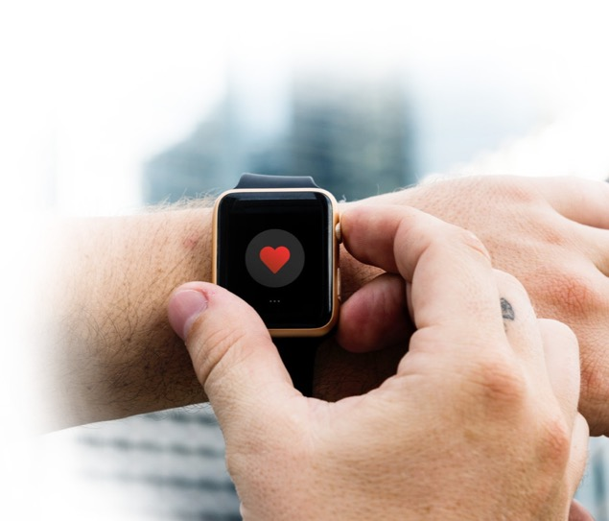
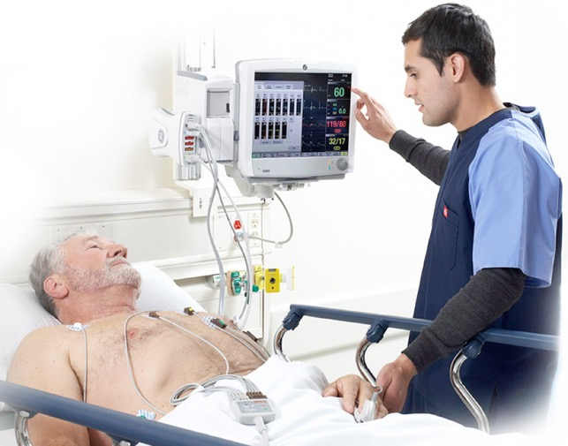

Slide 3

Recreational
Medical
Realtime HR
VO₂ Max
R-R Interval
CAN WE TRUST THEM?
Blood Pressure
?
Blood Profusion
Lactate Threshold
Stress
more…

Slide 4

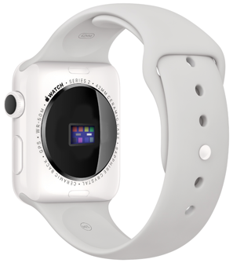
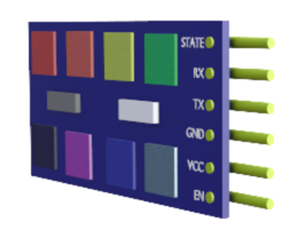
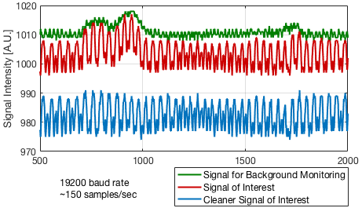
Today
PPG: well
established tech
Problem
measurement
reliability
Our Solution
multi-wavelength PPG
proprietary signal analysis

Slide 5

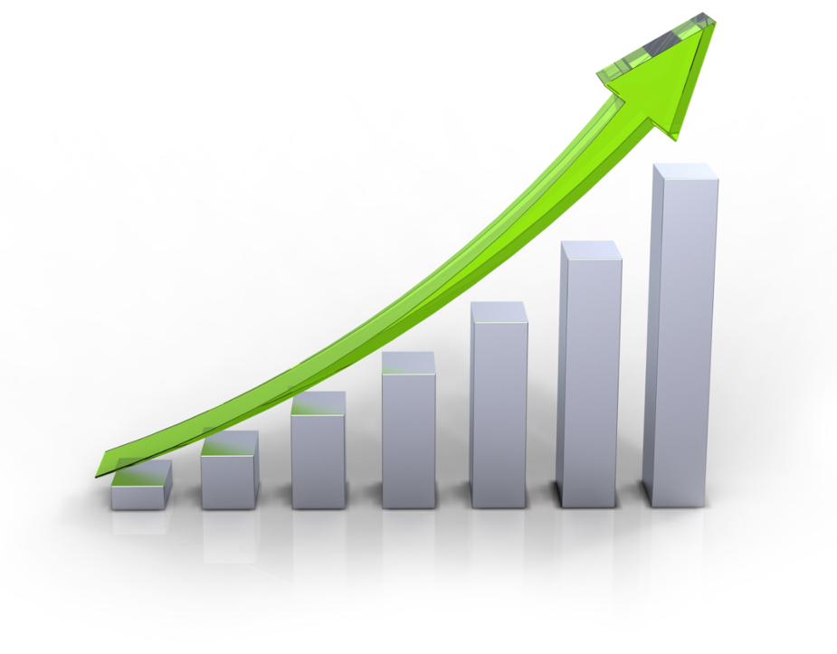
Global wearable medical devices market: ~20B$ (2016)
CAGR: 7-9%
Main players in the US:
Main competition:
Notes:
https://www.futuremarketinsights.com/reports/wearable-medical-devices-market

Slide 6


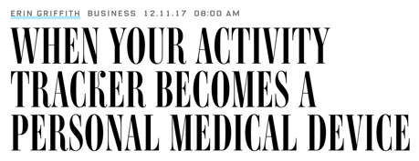
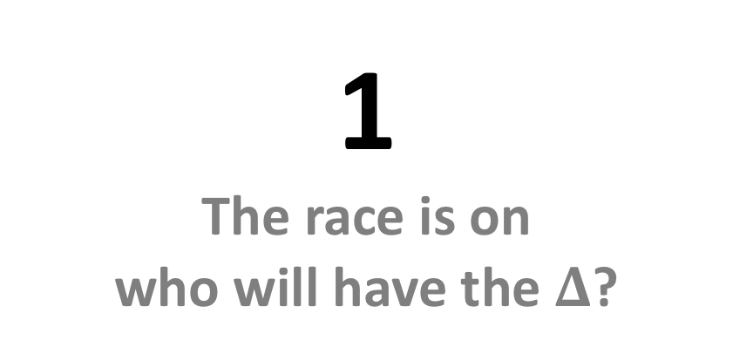
1
The race is on
who will have the $Δ$?
2
Window into the medical world
3
Early adopters era is over
Product-Market fit NOW

Slide 7


Step 1
Penetration via recreational
(partnership,
avoid regulation,
maturate tech)
Step 2
Step 3
Establishment in the medical market
Isolate relative advantage

Slide 8


500K$ and 6 months for:
Tech.
de-risking
prototype
algorithms
Gain experience
stack data
Legal
patenting
regulation first steps
Business pilot
identifying
partner
business development
Business Plan Step 1

Slide 9

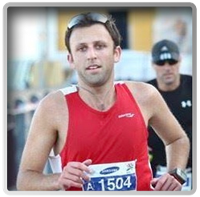
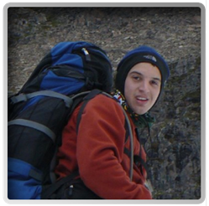
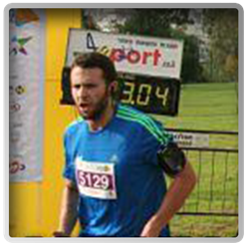
Tomer
Materials engineer, Intel
Iftach
Talpiot graduate, IAF, Biomedical engineer
Doron
Talpiot graduate, ITU, Biomedical engineer
Process engineering
Large scale project managing
Electro-optics
Over a decade of long distance running and wearable usage

Slide 10

Patents
  We have performed a wide survey
  Many similar technologies, but nothing identical
  Further analysis is required for identifying patenting strategy
Regulation?
  First step – not required
  Will aim for 510(K) during step 2 of the business plan

